Slide 1
External Sorting
Chapter 13
Notes:
1
The slides for this text are organized into chapters. This lecture covers Chapter 13, and discusses external sorting. Sorting is one of the most frequent database operations, and is optimized for I/O costs, leading to some interesting differences with in-memory sorting.
It should be covered after Chapter 8, which provides an overview of storage and indexing. At the instructor’s discretion, it can also be omitted without loss of continuity in other parts of the text. (In particular, Chapter 20 can be covered without covering this chapter.)
This chapter is most appropriate for a course with an implementation emphasis, and we suggest omitting it in a course with an applications emphasis.

Slide 2
Why Sort?
A classic problem in computer science!
Data requested in sorted order
  e.g., find students in increasing gpa order
Where did we encounter sorting?
  Sorting is first step in bulk loading B+ tree index.
  Sorting useful for eliminating duplicate copies in a collection of records (Why?)
  Sort-merge join algorithm involves sorting.
Notes:
4

Slide 3
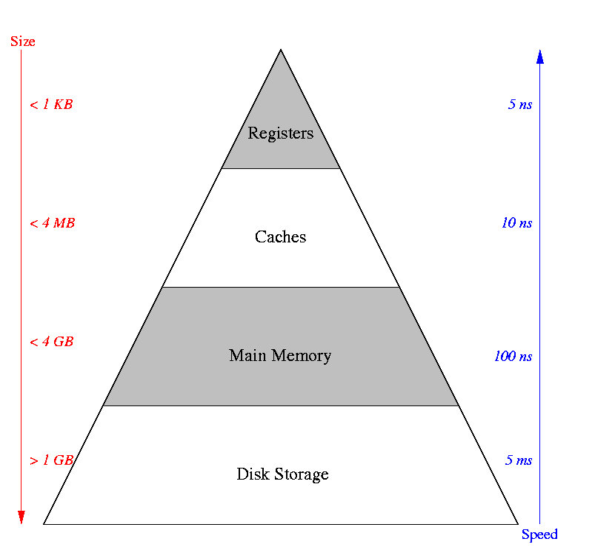

Recall (from OS Class) Memory Hierarchy
Put equal emphasis on all CS classes!
Minimize the number of disk accesses!

Slide 4
Cost Model
Internal Sort versus External Sort
Big O notation versus I/O cost
General Wisdom
  I/O costs dominate
  Design algorithms to reduce I/O

Slide 5
External Sorting
Problem: Sort 1000Gb of data with 1Gb of RAM.
  why not virtual memory?
When a file doesn’t fit in memory, there are two stages in sorting:
  File is divided into several segments, each of which sorted separately
  Sorted segments are merged
  Each stage involves reading and writing the file at least once!

Slide 6
2-Way Sort: Requires 3 Buffers
Pass 1: Read a page, sort it, write it.
  only one buffer page is used
Pass 2, 3, …, etc.:
  three buffer pages used.
INPUT 1
OUTPUT
INPUT 2
Main memory buffers
Disk
Disk
Notes:
5

Slide 7
Main-Memory Merge Sort
Merge-Sort(A)
01 if length(A) > 1 then
02 Copy the first half of A into array A1
03 Copy the second half of A into array A2
04 Merge-Sort(A1)
05 Merge-Sort(A2)
06 Merge(A, A1, A2)
Divide
Conquer
Combine

Slide 8
Main Memory 2-Way Merge Sort
2
3
5
6
1
4
8
9
1
2
. . .
3
4
Input page 1
Input page 2
Output page
Disk
Settings:
  A frame holds 4 keys.

Slide 9
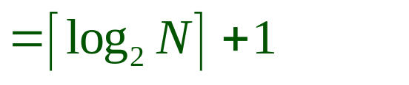
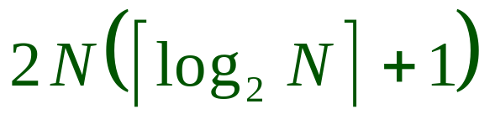
Two-Way External Merge Sort
Each pass we read + write each page in file.
N pages in the file => the number of passes
So total cost is:
Idea: Divide and conquer: sort subfiles and merge
3,4
6,2
9,4
8,7
5,6
3,1
2
Input file
PASS 0
3,4
2,6
4,9
7,8
5,6
1,3
2
1-page runs
PASS 1
2,3
4,7
1,3
2-page runs
4,6
8,9
5,6
2
PASS 2
2,3
4,4
1,2
4-page runs
6,7
3,5
8,9
6
PASS 3
1,2
2,3
3,4
8-page runs
4,5
6,6
7,8
9
Notes:
6

Slide 10
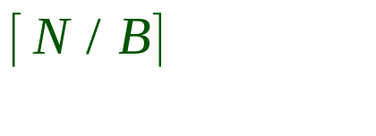
General External Merge Sort
More than 3 buffer pages. How can we utilize them?
To sort a file with N pages using B buffer pages:
  Pass 0: use B buffer pages. Produce sorted runs of B pages each.
  Pass 2, …, etc.: merge B-1 runs.
INPUT 1
. . .
INPUT 2
. . .
. . .
OUTPUT
INPUT B-1
Disk
Disk
B Main memory buffers
Notes:
7

Slide 11
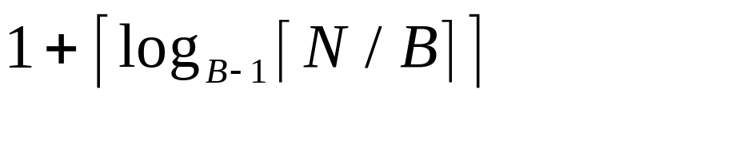
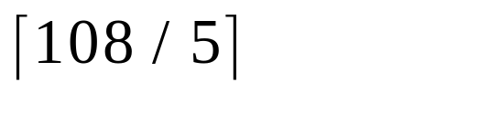
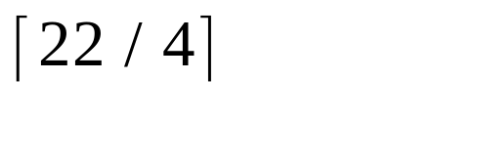
Cost of External Merge Sort
Number of passes:
Cost = 2N * (# of passes)
E.g., with 5 buffer pages, to sort 108 page file:
  Pass 0: = 22 sorted runs of 5 pages each (last run is only 3 pages)
  Pass 1: = 6 sorted runs of 20 pages each (last run is only 8 pages)
  Pass 2: 2 sorted runs, 80 pages and 28 pages
  Pass 3: Sorted file of 108 pages
Notes:
8

Slide 12
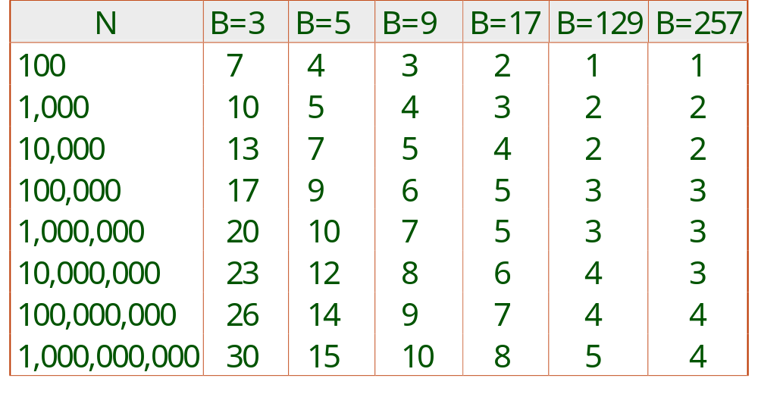
Number of Passes of External Sort
Notes:
9

Slide 13
Finding the minimum item
When the number of lists is small (K≤ 8) sequential search among items works nicely. (O(K))
When the number of lists is large, we could place the items in a priority queue (an array heap).
  The min value will be at the root (1st position in array)
Replace the root with the next value from the associated list.
  This insert operation is O(log K)

Slide 14
Internal Sort Algorithm
Quicksort is a fast way to sort in memory.
An alternative is “tournament sort” (a.k.a. “heapsort”)
  Top: Read in B blocks
  Output: move smallest record to output buffer
  Read in a new record r
  insert r into “heap”
  if r not smallest, then GOTO Output
  else remove r from “heap”
  output “heap” in order; GOTO Top
Notes:
10

Slide 15
I/O for External Merge Sort
… longer runs often means fewer passes!
Actually, do I/O a page at a time
In fact, read a block of pages sequentially!
Suggests we should make each buffer (input/output) be a block of pages.
  But this will reduce fan-out during merge passes!
  In practice, most files still sorted in 2-3 passes.

Slide 16
Double Buffering
To reduce wait time for I/O request to complete, can prefetch into `shadow block’.
  Potentially, more passes; in practice, most files still sorted in 2-3 passes.
INPUT 1
INPUT 1'
INPUT 2
OUTPUT
INPUT 2'
OUTPUT'
b
Disk
INPUT k
block size
Disk
INPUT k'
B main memory buffers, k-way merge

Slide 17


Using B+ Trees for Sorting
Scenario: Table to be sorted has B+ tree index on sorting column(s).
Idea: Can retrieve records in order by traversing leaf pages.
Is this a good idea?
Cases to consider:
  B+ tree is clustered
  B+ tree is not clustered
    Could be a very bad idea!
Notes:
15

Slide 18
Clustered B+ Tree Used for Sorting
Cost: root to the left-most leaf, then retrieve all leaf pages (Alternative 1)
If Alternative 2 is used?
  Additional cost of retrieving data records: each page fetched just once.
Index
(Directs search)
Data Entries
("Sequence set")
Data Records
Always better than external sorting!
Notes:
16

Slide 19
Unclustered B+ Tree Used for Sorting
Alternative (2) for data entries; each data entry contains rid of a data record. In general, one I/O per data record!
Index
(Directs search)
Data Entries
("Sequence set")
Data Records
Notes:
17

Slide 20
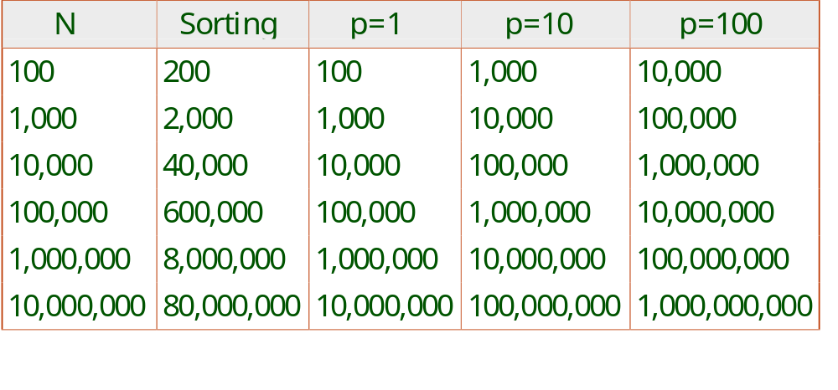
External Sorting vs. Unclustered Index
p: # of records per page
B=1,000 and block size=32 for sorting
p=100 is the more realistic value.
Notes:
18

Slide 21
Summary
External sorting is important; DBMS may dedicate part of buffer pool for sorting!
External merge sort minimizes disk I/O cost:
  Pass 0: Produces sorted runs of size B (# buffer pages). Later passes: merge runs.
  # of runs merged at a time depends on B, and block size.
  Larger block size means less I/O cost per page.
  Larger block size means smaller # runs merged.
  In practice, # of runs rarely more than 2 or 3.
Notes:
19

Slide 22
Summary, cont.
Choice of internal sort algorithm may matter:
  Quicksort: Quick!
  Heap/tournament sort: slower (2x), longer runs
The best sorts are wildly fast:
  Despite 40+ years of research, we’re still improving!
Clustered B+ tree is good for sorting; unclustered tree is usually very bad.

